Slide 1
Items Needed for Meteorology Class

Slide 2
Bring these items with you to class every day.
Notebook
Pencil / Blue or Black ink pen
Folder (for loose leaf papers)
Textbook
Calculator
Agenda

Slide 3
Graded Items
Tests
Notes from Power point (Notebook)
Notes from Lab work (Notebook)
Quizzes
Worksheets (Study Guides)
Computer Based Learning
Lab work and Reports
Videos, CDs, DVDs (Notes, discussion, answers to questions)

Slide 4
Grading Scale
95% - 100% …………….A
90% - 94.4%...................A-
85% - 89.4%...................B
80% - 84.4%...................B-
75% - 79.4%...................C
70% - 74.4%...................C-
65% - 69.4%...................D
60% - 64.4%...................D-
0 – 59.4%........................F

Slide 5
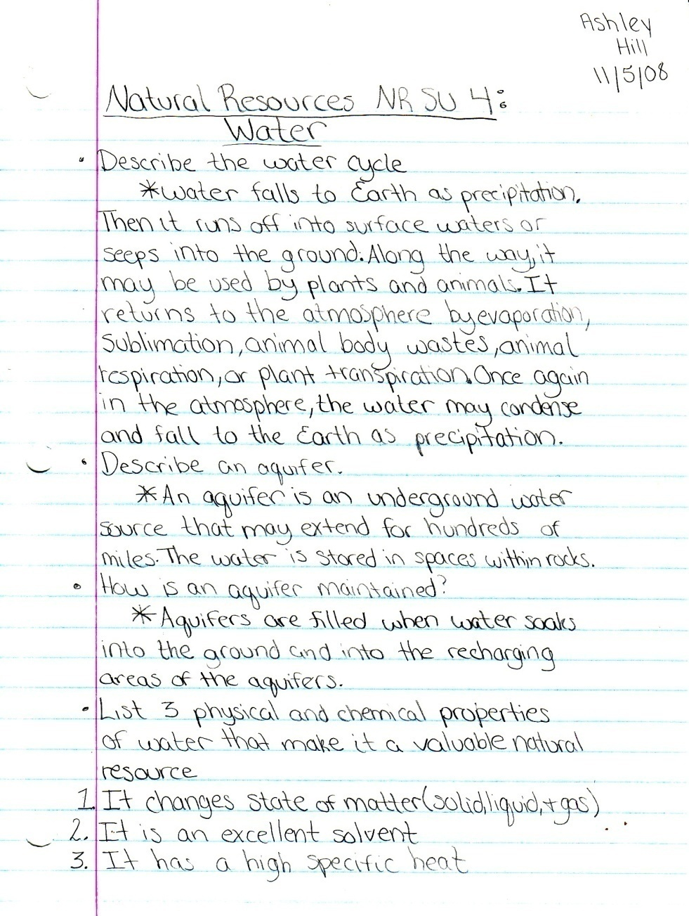
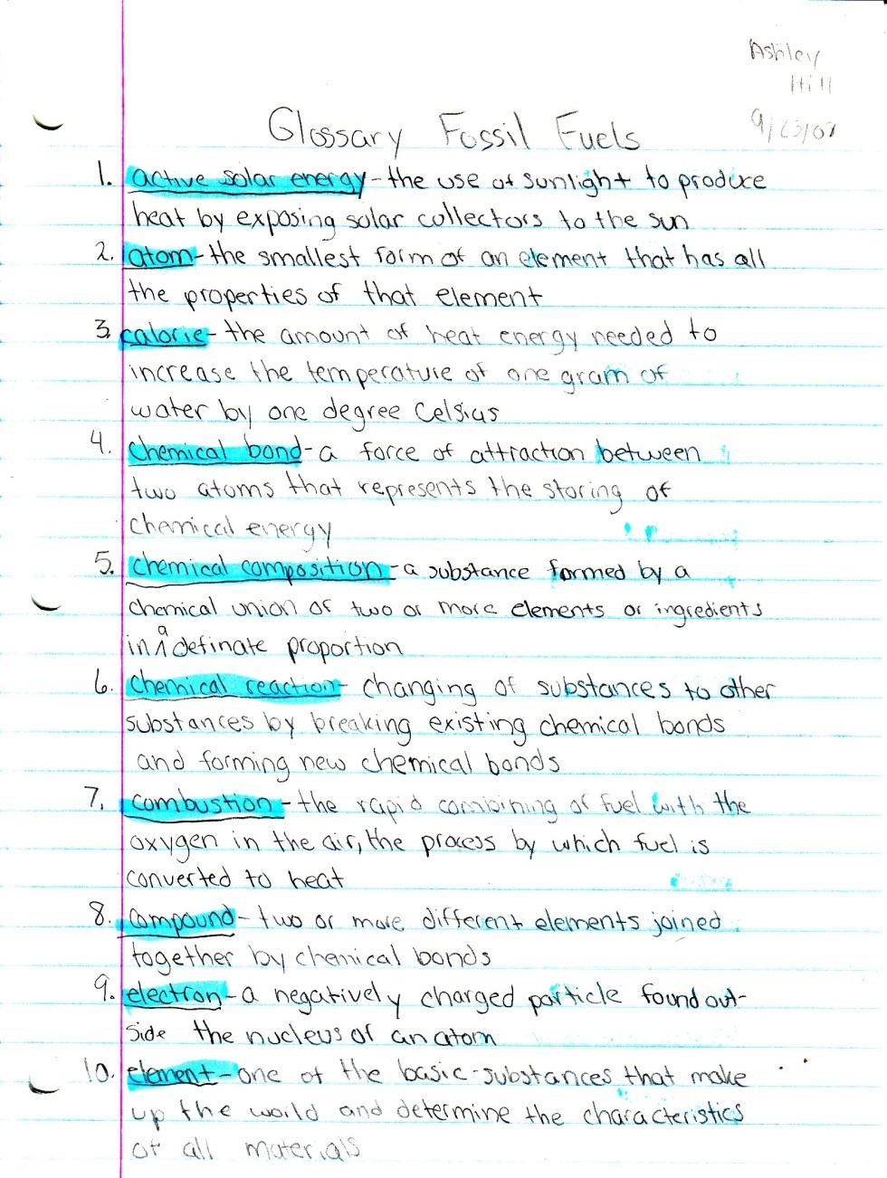
Notebook Format:

Slide 6
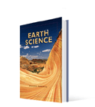
Required Text

