Slide 1
Chapter 12 Worksheets
Section 1-4

Slide 2
12.1 After You Read:
1. Write each example of weathering in the correct column, depending on whether it is mechanical or chemical, choosing examples from this list: acids in water, roots growing in cracks, burrowing animals, oxygen acting on iron, moving sand and pebbles, upward expansion.
Mechanical | Chemical
Similarities in shapes of the continents; same fossils and distinctive rock formations found in South America and Africa; climate change evidence.
Roots growing in cracks
Acids in water
Upward expansion
Oxygen acting on iron
Moving sand and pebbles
Location of earthquakes and volcanoes; magnetism of ocean floor; age of ocean floor.
Burrowing animals

Slide 3
12.1 After You Read:
What are three factors that make a rock susceptible to weathering?
More surface exposed
Rock composed of minerals such as feldspar or calcite
Warm, wet climates

Slide 4
12.2 Soil
Complete the diagram to show the different features and types of soil.

Slide 5
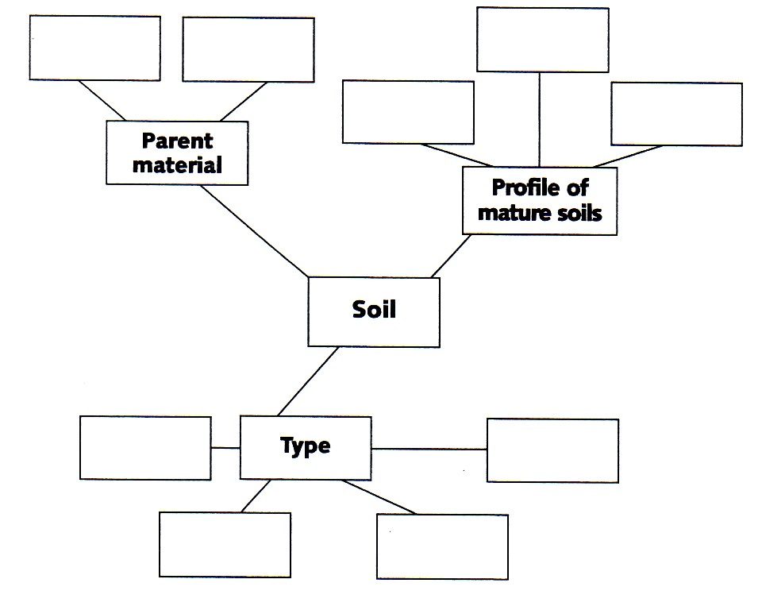
12.2 Soil While You Read
arctic
Transported soil
Residual soil
tropical
C-horizon
B-horizon
A-horizon
desert
temperate

Slide 6
12.2 Soil After You Read
Name four factors that affect soil composition.
Time
Parent material
Topography
climate

Slide 7
12.3 Mass Movements and Erosion
Fill out the graphic organizer. On the left side, write four agents of erosion. On the right side, write the name and a brief description of each type of landslide.

Slide 8
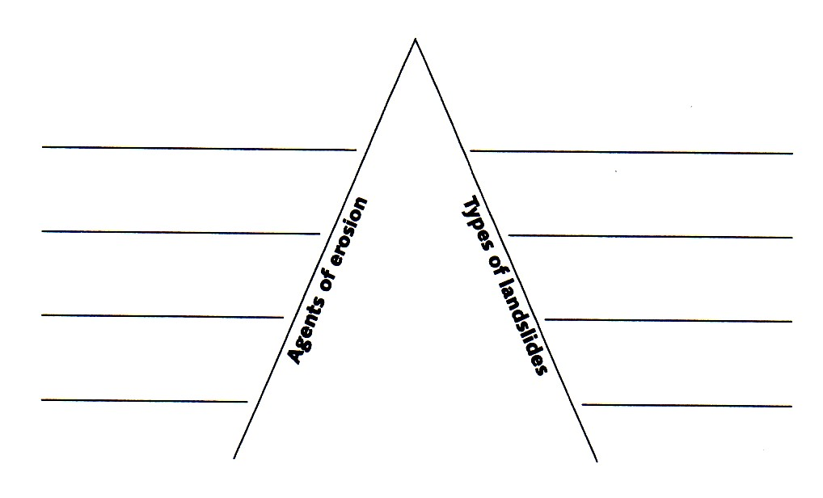
12.3 Mass Movements and Erosion
Ocean waves and currents
Creep
Rivers and Streams
Slump
Wind
Mudflow
Glaciers
Earthflow

Slide 9
12.3 Mass Movements and Erosion / After You Read
Explain in two or three sentences how climate and rock composition affect rates of erosion.
Because water is a powerful agent of erosion, regions with humid climates tend to have rounded (more eroded) topography. Some types of rock tend to weather easily, whereas others, such as igneous rock, tend to resist weathering agents.

Slide 10
12.3 Mass Movements and Erosion / After You Read
Briefly define each type of landslide you named in the graphic organizer.
Creep – a slow movement of soil down a slope
Slump – the movement of blocks of land downward along a sloping surface
Mudflow – the rapid movement of large amounts of clay and silt suspended in water
Earthflow – the slow movement of weathered material saturated with water

Slide 11
12.4 Soil as a Resource
Demonstrate the process of soil depletion by completing the graphic organizer. First, fill in the events that occur with natural vegetation. Then show how the cycle differs when it involves plants raised for food.

Slide 12
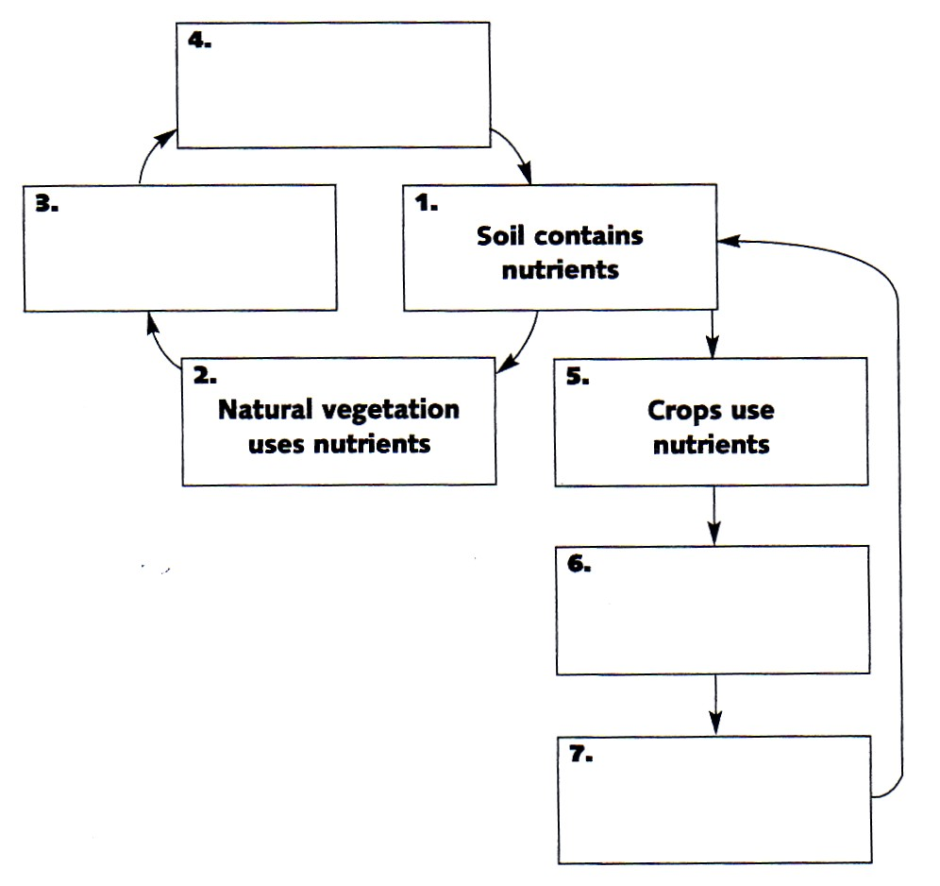
12.4 Soil as a Resource
Nutrients return to soil
Plants die and decompose in ground
Crops are harvested
Fertilizers must be added to replace nutrients

Slide 13
12.4 Soil as a Resource
List and briefly describe three methods of preventing erosion of farmland.
Windbreaks: planting trees along the edges of fields to reduce wind erosion.
Contour farming: on slopes, planting crops parallel to land contours to control runoff.
Terraces: flattened sections of a slope to slow runoff
Strip cropping: alternating a crop that leaves some ground bare with a crop that covers ground.
No-till: after planting, soil is not disturbed until harvest.

