Slide 1
Biology: Populations

Slide 2
Q1: How did the moose population change between 1965 and 1975?
The population increased and peaked at 1500 moose, then decreased slightly.

Slide 3
Q2: What happened to the wolf population from 1970 to 1976?
The wolf population increased rapidly from less than 20 wolves to more than 40.
Numbers are optional for these questions, however it is really important to explain how quickly a population has increased or decreased as rate gives us a better idea of how a population is changing over time.

Slide 4
Q3: Infer how the change in the moose population might have led to the change in the wolf population?
The increase in the abundance of moose as a food source provides a more suitable reproductive environment for the wolves. This means that the wolves can reproduce more successfully with a lower death rate and this would explain their population increase.

Slide 5
Q4: What is the highest recorded population of wolves & in what year?
50 in 1980
This question requires you to be able to read the graph correctly. Draw lines when the graphs are not clearly marked, and ensure that you check the axis carefully so that you don’t read the population of moose by mistake.

Slide 6
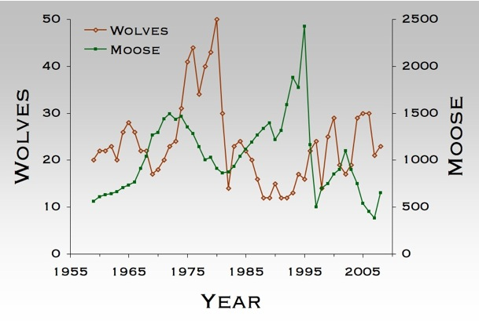

Slide 7
Q5: The wolves experience widespread disease which causes high levels of mortality in the wolf population.
Explain how a disease causing a rapid decline in the wolf population would affect the moose population and why?
A rapid decline in the wolf population means that there are less predators in the area and therefore the death rate of the moose would decrease. A lowered death rate would allow for more moose to reproduce which in turn would lead to an increase in moose population.

Slide 8
Will the moose population grow exponentially if the wolves were to become extinct following this disease? Justify your answer with reference to abiotic and biotic factors that would likely affect this organism.
The moose reproduce sexually and so the population is unlikely to increase exponentially due to the fact these organisms reproduce slowly. There will be a rapid increase in the population due to the absence of wolves (Predation), however as the population grows there will be more competition for resources (Intraspecific factors). The carrying capacity will limit the population and when the moose population reaches this, the growth rate will level out and the population should stabilize.

Slide 9
Q6: Explain the likely cause/s of the rapid decline in the numbers of wolves between 1980 and 1982.
The rapid decline is likely due to either widespread disease which effects only the wolves, diminished populations of their primary food source or the influence of humans (Culling and hunting). The introduction of a higher order predator such as a bear may have also caused a rapid decline in this instance.

