Slide 1
Biology Chapter 1
Study Notes

Slide 2
Science is an organized way of using evidence to learn about the natural world.
The information gathered from observations is called data.
    Quantitative data are expressed as numbers, obtained by counting or measuring.
    Qualitative data are descriptive and involve characteristics that can’t easily be measured.
A hypothesis must be proposed in a way that can be tested.
Hypotheses are tested by performing controlled experiments or by gathering new data.
The variable that is deliberately changed is called the manipulated (Independent) variable.
The variable that is observed and that changes in response to the manipulated (Dependent) variable is called the responding variable.

Slide 3
Controlled experiments allow the scientist to isolate and test a single variable.
In science, the word theory applies to a well-tested explanation that unifies a broad range of observations.
Living things reproduce.
In sexual reproduction, cells from two different parents unite to form the first cell of the new organism.
In asexual reproduction, a single parent produces offspring that are identical to itself.
  Living things share the following characteristics:
    made up of units called cells
    reproduce
    based on a universal genetic code
    grow and develop
    obtain and use materials and energy
    respond to their environment
    maintain a stable internal environment
    change over time

Slide 4
Compound light microscopes allow light to pass through the specimen and use two lenses to form an image.
Electron microscopes use beams of electrons, rather than light, to produce images.
Levels of Organization
  Atoms
  Molecules
  Organelles
  Cells
  Tissues
  Organs
  Organ systems
  Organism
  Population
  Community
  Ecosystem
  Biosphere

Slide 5
Key Vocabulary from Chapter 1:
Biology
Cell culture
Cell fractionation
Data
Evolution
Homeostasis
Hypothesis
Metabolism
Metric system
Microscope
Stimulus
Theory
Spontaneous generation

Slide 6
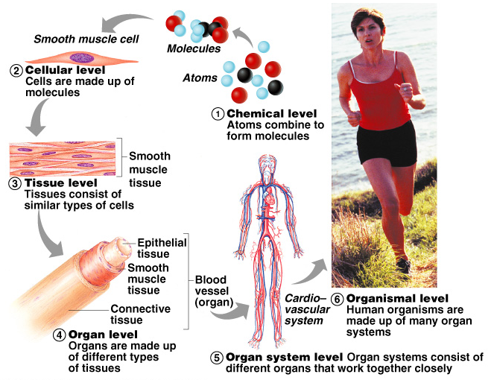
Levels of Structural Organization
Atoms
Molecules
Organelles
Cells
Tissues
Organs
Organ systems
Organism

Slide 7
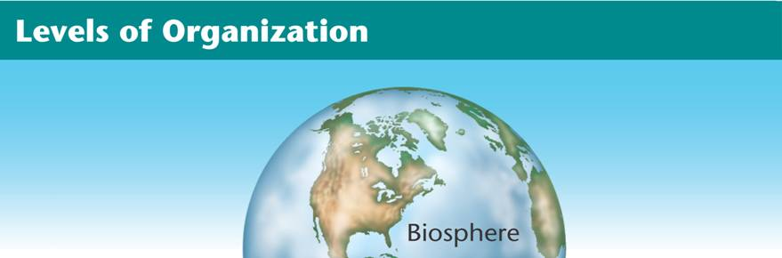
Branches of Biology
Biosphere
The part of Earth that contains all ecosystems
Notes:
Living things may be studied on many different levels. The largest and most complex level is the biosphere. The smallest level is the molecules that make up living things.

Slide 8
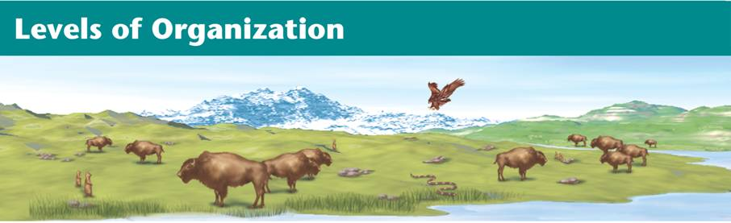
Branches of Biology
Ecosystem
Community and its nonliving surroundings
Hawk, snake, bison, prairie dog, grass, stream, rocks, air
Notes:
Living things may be studied on many different levels. The largest and most complex level is the biosphere. The smallest level is the molecules that make up living things.

Slide 9
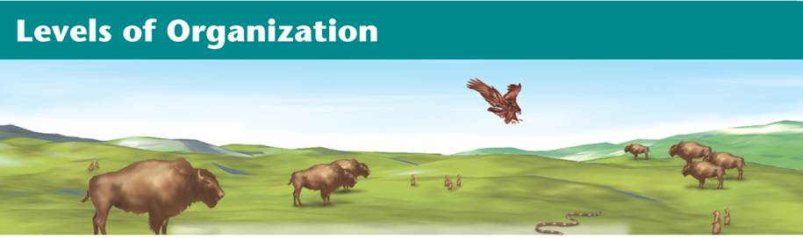
Branches of Biology
Community
Populations that live together in a defined area
Hawk, snake, bison, prairie dog, grass
Notes:
Living things may be studied on many different levels. The largest and most complex level is the biosphere. The smallest level is the molecules that make up living things.

Slide 10
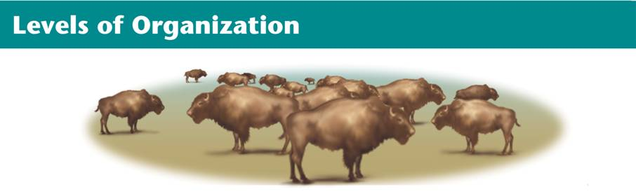
Branches of Biology
Population
Group of organisms of one type that live in the same area
Bison herd
Notes:
Living things may be studied on many different levels. The largest and most complex level is the biosphere. The smallest level is the molecules that make up living things.

Slide 11
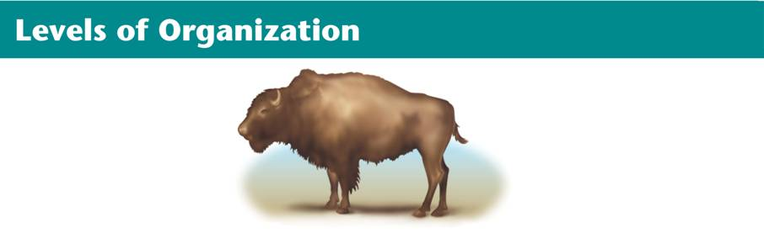
Branches of Biology
Organism
Individual living thing
Bison
Notes:
Living things may be studied on many different levels. The largest and most complex level is the biosphere. The smallest level is the molecules that make up living things.

Slide 12
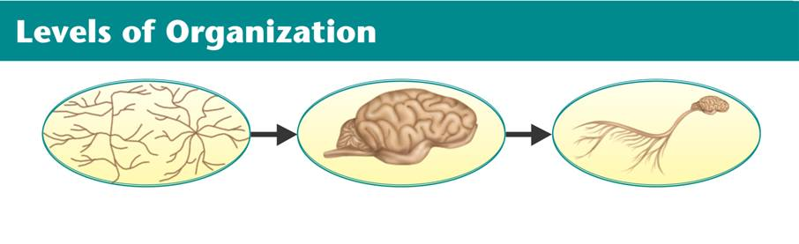
Branches of Biology
Groups of Cells
Tissues, organs, and organ systems
Nervous tissue Brain Nervous system
Notes:
Living things may be studied on many different levels. The largest and most complex level is the biosphere. The smallest level is the molecules that make up living things.

Slide 13
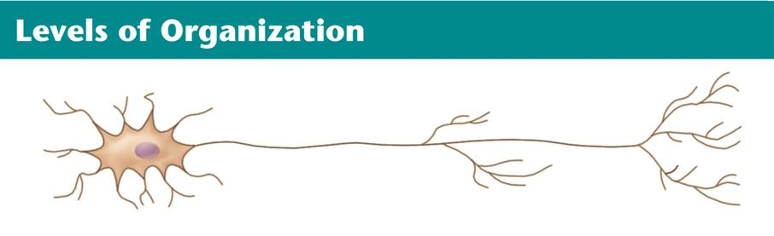
Branches of Biology
Cells
Smallest functional unit of life
Nerve cell
Notes:
Living things may be studied on many different levels. The largest and most complex level is the biosphere. The smallest level is the molecules that make up living things.

Slide 14
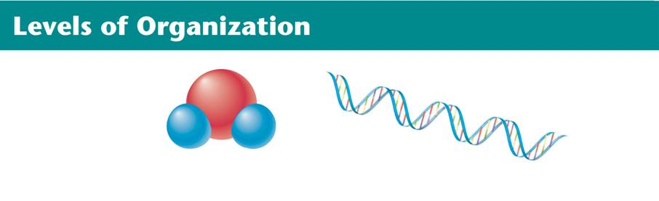
Branches of Biology
Molecules
Groups of atoms; smallest unit of most chemical compounds
Water DNA
Notes:
Living things may be studied on many different levels. The largest and most complex level is the biosphere. The smallest level is the molecules that make up living things.

Slide 15
Branches of Biology
At all these levels, smaller living systems are found within larger systems.

